Slide 1
The Intelligent Digital workforce

Slide 2
Introduction to Enovation
Dutch Company – market leading healthcare software solution provider in NL founded 1983
One-stop-shop of solutions enabling clients to securely exchange patient data by leveraging efficient IT integrations.
Cloverleaf Integration & Information Exchange suite
myhealthConnect
Blueprism RPA
xdsConnect
Enterprise Master Patient Index
Sheila Mughal & Neil Spencer
07714 248180 07734 391371

Slide 3
True or False Question
All large organisations employ armies of robots to perform manual, repetitive, rules based admin work which is
Mundane
Really boring
Delivers no job satisfaction
But is vital to ensure business process flows work – especially when IT applications don’t share information

Slide 4
TruE
All large organisations DO employ armies of robots to perform manual, repetitive, rules based admin work which is
Mundane
Really boring
Delivers no job satisfaction
But is vital to ensure business process flows work – especially when IT applications don’t share information
They are cunningly disguised as PEOPLE !

Slide 5
Robotic Process Automation
What is it?
Why does it exist?
How is it helping improve operational performance?
Informing a business case

Slide 6
What is it?
https://www.youtube.com/watch?v=4CXbr-YkkVY

Slide 7
Why does it exist?
1000000000’s of hours are being spent by people working like Robots
Health & Social Care is not immune!
Fact 1: It’s not a perfect world! Many systems don’t talk to each other,
but they are vital to supporting citizens / patients.
Fact 2: We accept this situation & rely on people to bridge the gaps.
enables the automation of such tasks to improve
productivity and gain back time to focus on higher value activities.
Notes:
Modern organisations are complex with multiple departments, multiple systems and multiple business processes and those processes can span multiple departments and cut across multiple systems. We use a combination of technology and people to fulfil the business processes that are demanded of us. Quite often the technology we use cant be adapted, evolved or developed at the speed in which the business requires, so we end up using people to fill the gap between technology and process.
In many cases people add value to processes, interacting with customers, citizens, patients… making value judgements or interpreting data and information that IT systems cant understand. But in a large number of areas, people are simply filling the gaps, following prescribed rules and performing repetitive actions in order to fulfil steps of a process. These people are in effect working like robots.

Slide 8
Specific use case examples

Slide 9
How is it helping the NHS
A myriad of use cases
Electronic Referrals
Patient Registrations & address changes
Supporting Digital Dictation Projects
Document Management
Self Service Kiosks
Automated Case Note Tracking updates
Automated follow up appointment booking
Patient discharge and initial referral closure (closing the loop)
Global Patient record updates with additional standard information
Automating parts of the Clinical Correspondence generation
Sharing of Oxygen data with clinicians and GP’s
Automation of NHS Jobs Processes
Electronic White Board Bed Management solutions – e.g. discharge
Write back to PAS solutions
Systems Quality Control and pro-active systems monitoring
Large scale data migrations
On-boarding and off-boarding staff access to systems / applications
Back Office Automations
Finance (e.g. invoice generation, invoice processing, reconciliation processing)
Supplies (Pharmacy stock control alignment to financial systems)
Payroll validation vs hours claimed by staff
etc

Slide 10
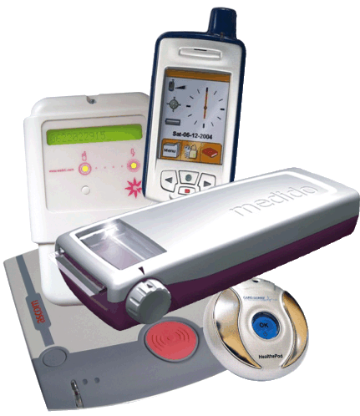
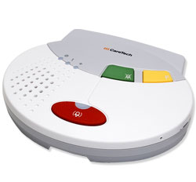
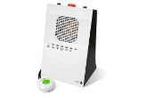
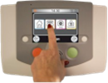
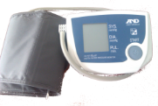
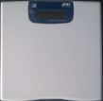
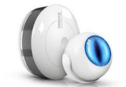
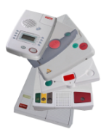
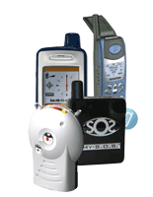
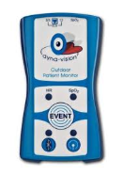
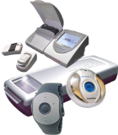
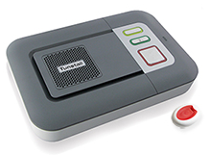
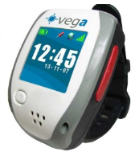
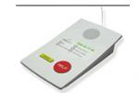
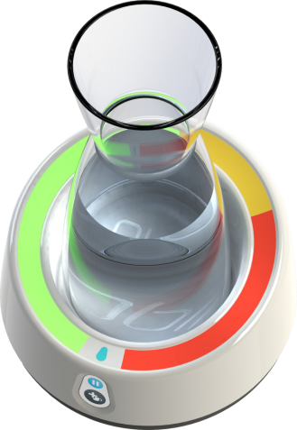
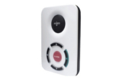
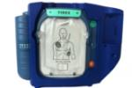
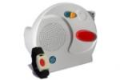
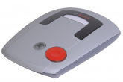
And there is more...
E-health
University students & General Practice
Seasonal peaks in workload
Reduce duplication of data entry
Automate repeat prescriptions
Automate follow-up test results (normal)
Automate follow-ups post discharge (smart voice)
Enable intercommunication between systems
Automate appointment reminders with patient response processing
Assisted living + proactive health monitoring
reducing risk of (re-)admission

Slide 11
Some recent proof of value exercises
Outpatient Clinics – aligning PAS with a Room Mngmnt System
SystmOne bedstates – exposing realtime situation using PowerBI
Automated follow-up booking once outcome recorded in outpatients
Extracting data as a user would to fill a gap in BI reporting
Validating that a care plan is in place for a service user
Processing images from scans to identify markers (or not) for suspected cancer to inform clinical review

Slide 12
Informing a business case
Taking a different approach (fictitious scenario)
On average 1 person will be productive for 6 hours per day (7.5 hr working day)
1 robot can be productive 24 hours per day, 7 days a week, 365 days per year
1 human can complete up to 1,400 hours of work per year
1 robot can complete up to 8,760 hours of robotic work per year (often faster than a human too)
Lets assume our robots will work twice as fast and there are 4 of them.
You can potentially save 70,000 hours of human admin work time per year.
@£14 per hour this would cost a business c. £1m per annum
What if you could employ a workforce to do the same work for c. £3 ~ £4 per hour?

Slide 13
Why do we continue to ask our employees to perform rules based administrative work that is…
unrewarding,
mind numbingly boring,
prone to error,
increasing the risk of attrition
Isn’t it time we take the robot out of the human and put 1’000’s hours back into patient / citizen care?

Slide 14
Some lessons learnt (my personal perspective)
Many organisations who invest in RPA are failing to embrace the potential at scale – why?
Tactical technology vs strategic enabling platform
Failing to manage change (technology is only part of a solution)
Lack of ownership
Lack of understanding
Lack of investment by customers and suppliers to manage ongoing programme
But there are success stories – learn from them.

Slide 15
So how do you get started?
Engage expertise to help you
identify your automation opportunities
build your business case
prove the value
define your strategy & inform a plan
Execute quickly – because you can
Manage change and drive continuous improvement

Slide 16
Thank you for your time.
Any Questions?

